Slide 1
Search Algorithms: Object-Oriented Implementation (Part C)

Slide 2
Contents
Conventional vs. AI Algorithms
Local Search Algorithms
Genetic Algorithm
Implementing Hill-Climbing Algorithms
Defining ‘Problem’ Class // 지난 강의 (Part C-1)
Adding Gradient Descent // 오늘 강의 (Part C-2)
Defining ‘HillClimbing’ Class
Adding More Algorithms and Classes
Adding Genetic Algorithm
Experiments

Slide 3
Migrating to Classes
Part C-1
Class implementation

Slide 4
Defining Classes
variables
problem.py source code define three classes
functions
Problem
solution
value
numEval
Numeric
Tsp
expression
domain
delta = 0.01
__init__
storeResult
report
numCities
locations
distanceTable
__init__
setVariables
getDelta (new)
randomInit
evaluate
mutants
mutate
randomMutant
describe
report
coordinate
__init__
setVariables
calcDistanceTable
randomInit
evaluate
mutants
inversion
randomMutant
describe
report
tenPerRow

Slide 5
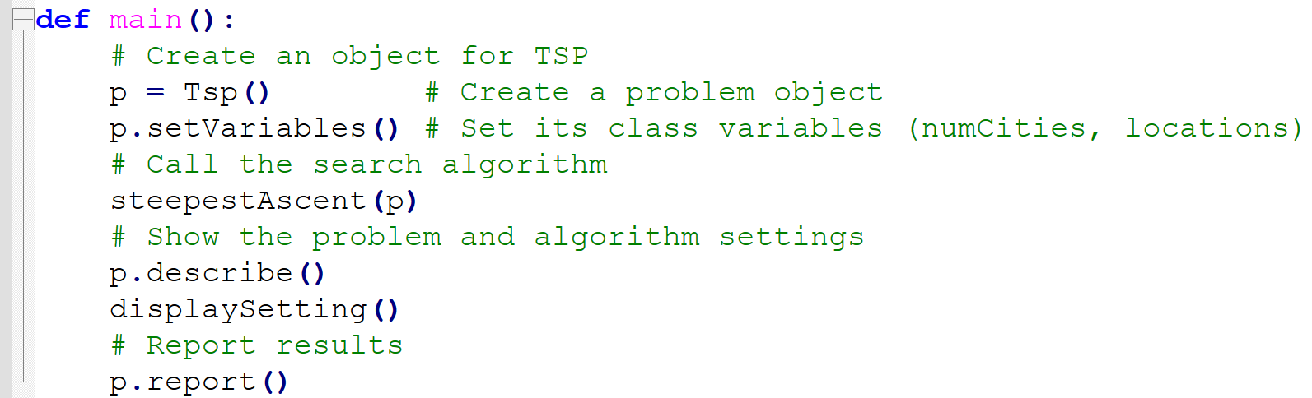
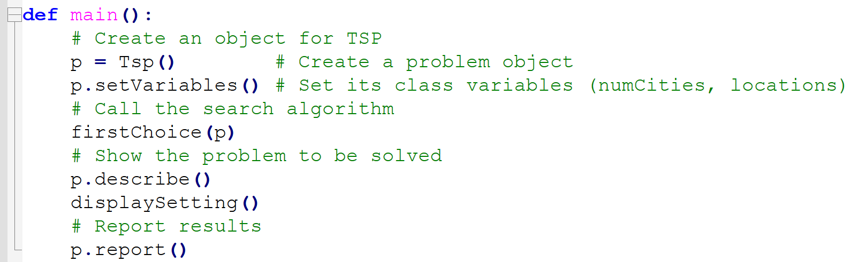
Code outside of problem.py
steepest ascent(tsp).py
first-choice(tsp).py
def main():
p = Tsp()
...
def steepestAscent(p):
...
def bestOf(neighbors,p):
...
def displaySetting():
...
main()
def main():
p = Tsp()
...
def firstChoice(p):
...
def displaySetting():
...
main()

Slide 6
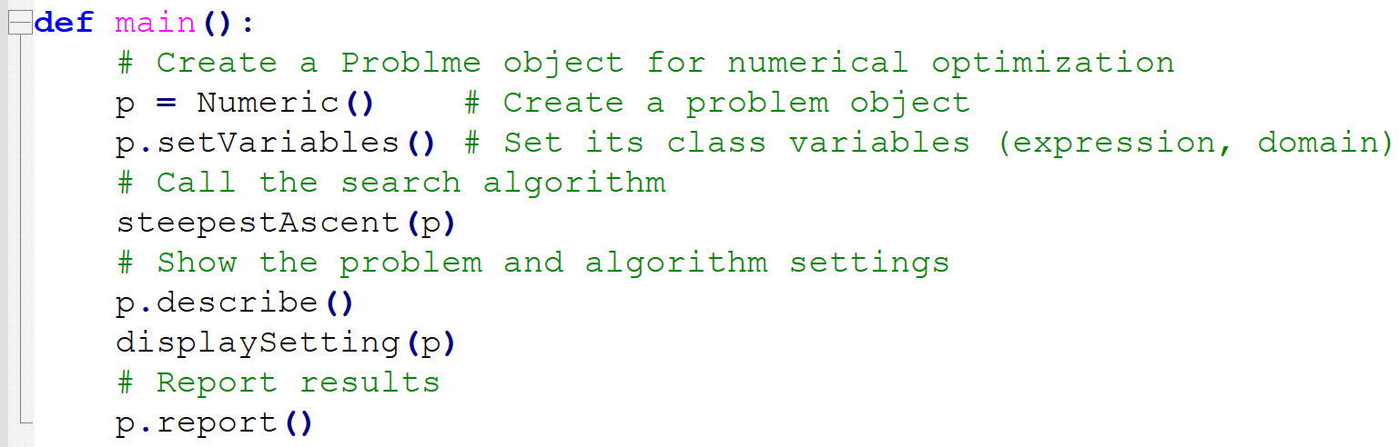
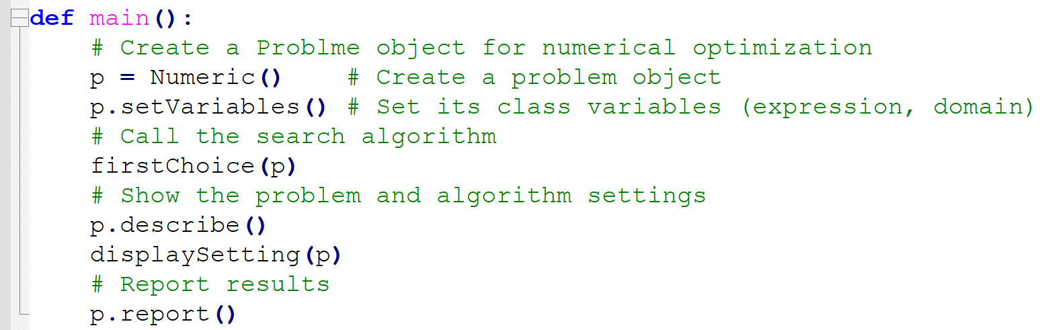
Code outside of problem.py
steepest ascent(n).py
first-choice(n).py
def main():
p = Numeric()
...
def steepestAscent(p):
...
def bestOf(neighbors,p):
...
def displaySetting(p):
...
main()
def main():
p = Numeric()
...
def firstChoice(p):
...
def displaySetting(p):
...
main()

Slide 7
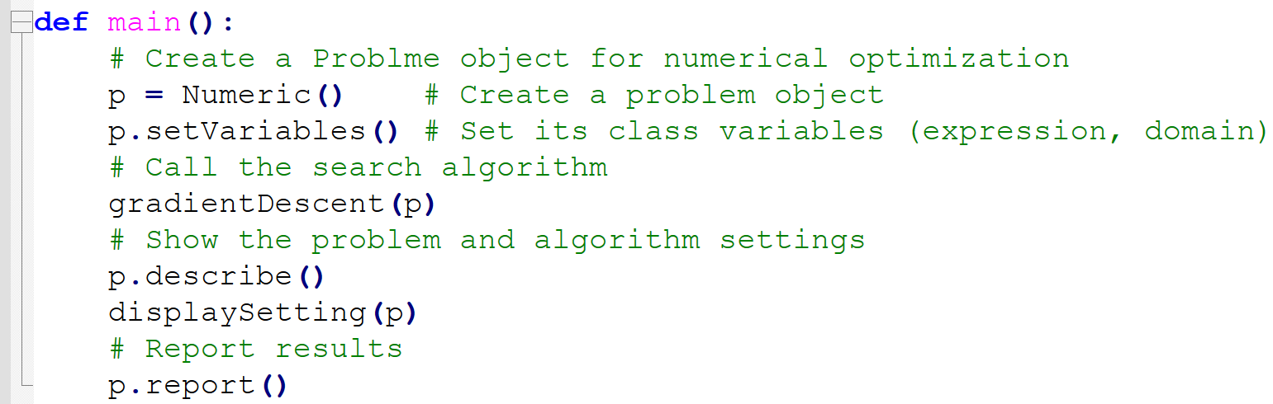
Code outside of problem.py
gradient descent.py
def main():
p = Numeric()
...
def gradientDescent(p):
...
def displaySetting(p):
...
main()
Today’s topic

Slide 8
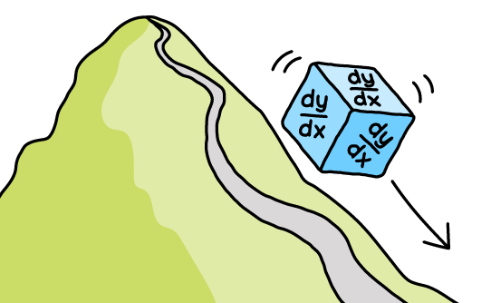
Gradient Descent Algo.
Part C-2
Solution for solving continuous variable problems

Slide 9
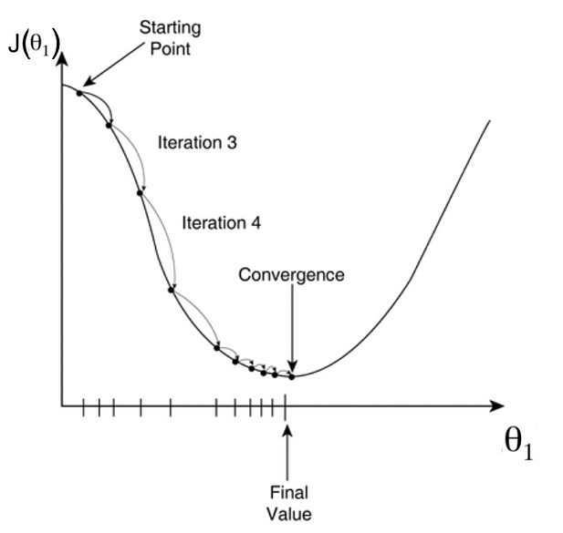
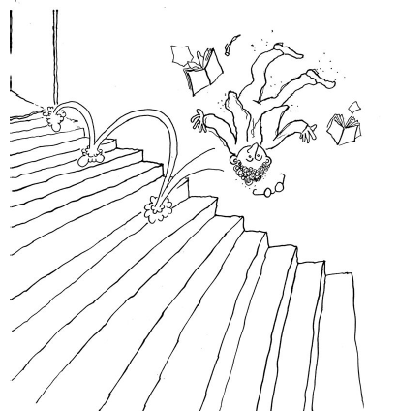
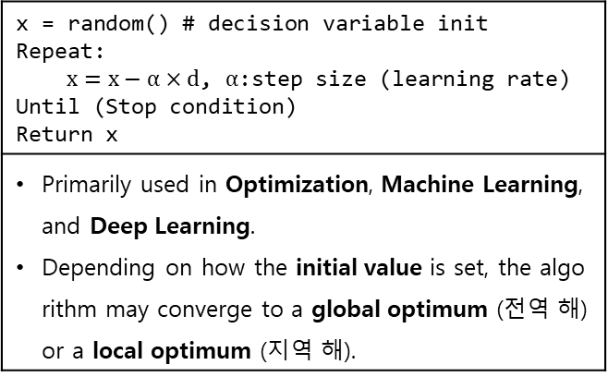
Gradient Descent Algorithm
General Descent Algorithm (When the objective is to minimize)
Finds the optimal solution by iteratively moving the variable's value slightly in the direction that makes the objective function smaller.
Find the direction d that reduces the objective function and change the variable's value by the step size.
x = random() # decision variable init Repeat: $x=x−α×d$, $α$:step size (learning rate) Until (Stop condition) Return x
Primarily used in Optimization, Machine Learning, and Deep Learning. Depending on how the initial value is set, the algorithm may converge to a global optimum (전역 해) or a local optimum (지역 해).

Slide 10
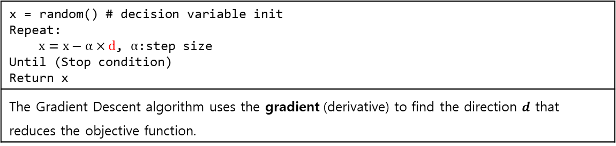
Gradient Descent Algorithm
Gradient Descent is referred to as a first-order iterative algorithm and is a representative technique for finding a local optimum.
Note: in case of convex optimization, local opt = global opt
Note: The search direction is determined using the first derivative (1차 미분 = gradient).
https://en.wikipedia.org/wiki/Gradient_descent
This lecture assumes a differentiable objective function.
x = random() # decision variable init Repeat: $x=x−α×d$, $α$:step size Until (Stop condition) Return x
The Gradient Descent algorithm uses the gradient (derivative) to find the direction $d$ that reduces the objective function.

Slide 11
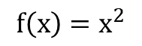
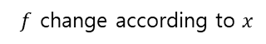
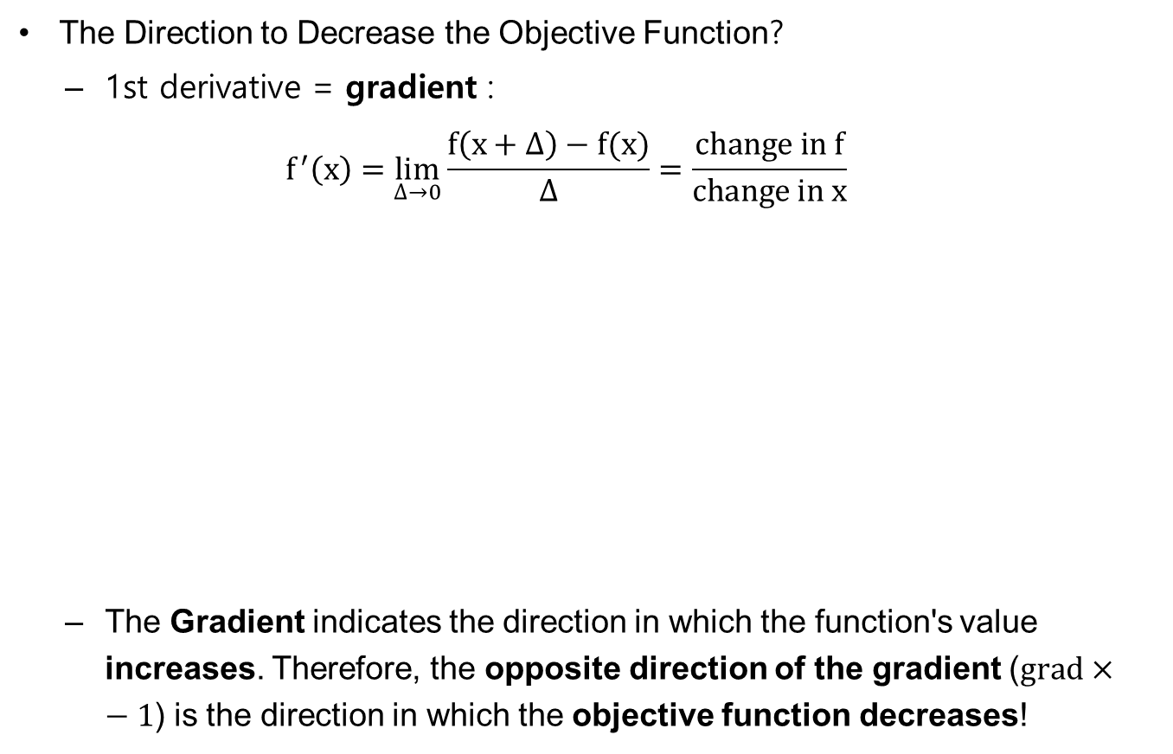
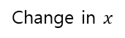
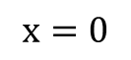
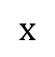
Gradient Descent Algorithm
The Direction to Decrease the Objective Function?
1st derivative = gradient : $f^{′}\left(x\right)=\lim_{∆→0}{\frac{f\left(x+∆\right)−f(x)}{∆}}=\frac{change in f}{change in x}$
The Gradient indicates the direction in which the function's value increases. Therefore, the opposite direction of the gradient ($\text{grad}×−1$) is the direction in which the objective function decreases!
$$f\left(x\right)=x^{2}$$
This is gradient
$f$ change according to $x$
Change in $x$
$$x$$
$$x=0$$

Slide 12
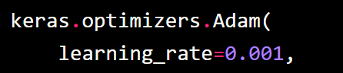
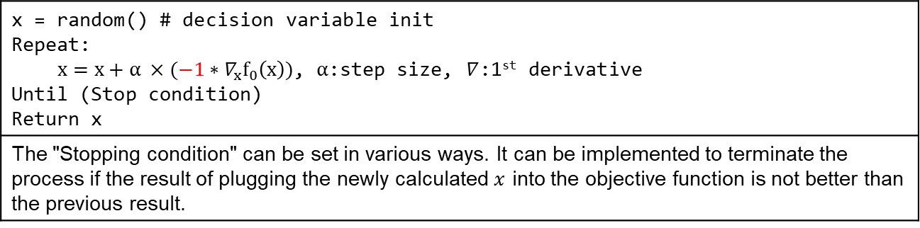
Gradient Descent Algorithm
A general algorithm for finding solutions to optimization problems: Descent Algorithm
Searches for the solution by moving a certain step size in the opposite direction of the Gradient.
The step size determines how much the decision variable will move in each iteration, In Machine and Deep Learning, this is called the learning rate (lr).
x = random() # decision variable init Repeat: $x=x+{α ×(−1∗∇}_{x}f_{0}\left(x\right))$, $α$:step size, $∇$:1st derivative Until (Stop condition) Return x
The "Stopping condition" can be set in various ways. It can be implemented to terminate the process if the result of plugging the newly calculated $x$ into the objective function is not better than the previous result.

Slide 13

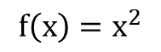
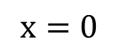
Gradient Descent Algorithm
If the step size(learning rate) is too small, it takes a long time to find the optimal solution
If the step size(learning rate) is too large? over-shooting may occurs:
So… how should the step size be?
$$f\left(x\right)=x^{2}$$
(1)
Algorithm keep overshooting Optimal solution and cannot reach it.
(3)
(2)
$$x$$
$$x=0$$

Slide 14
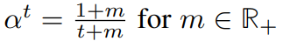
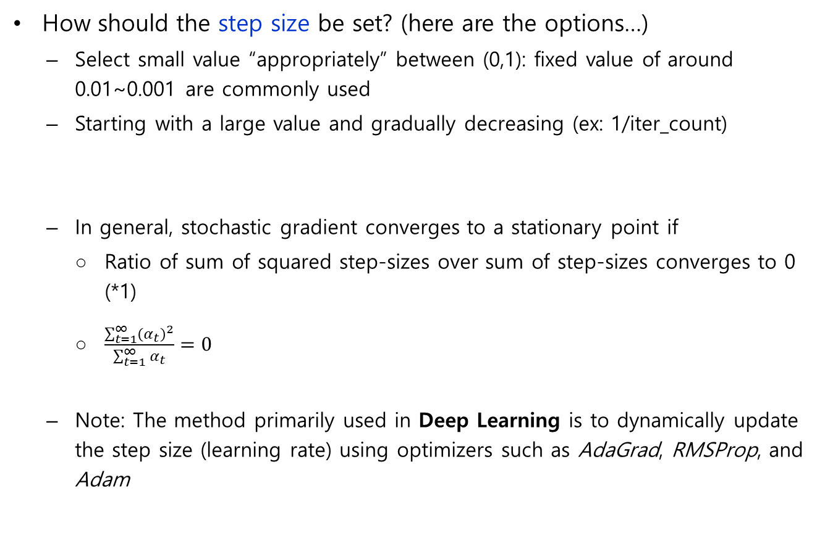
Gradient Descent Algorithm
How should the step size be set? (here are the options…)
Select small value “appropriately” between (0,1): fixed value of around 0.01~0.001 are commonly used
Starting with a large value and gradually decreasing (ex: 1/iter_count)
In general, stochastic gradient converges to a stationary point if
Ratio of sum of squared step-sizes over sum of step-sizes converges to 0 (*1)
$\frac{\sum_{t=1}^{∞}{{\left(α_{t}\right)}^{2}}}{\sum_{t=1}^{∞}{α_{t}}}=0$
Note: The method primarily used in Deep Learning is to dynamically update the step size (learning rate) using optimizers such as AdaGrad, RMSProp, and Adam
(*1) https://www.cs.ubc.ca/~fwood/CS340/lectures/L24.pdf

Slide 15
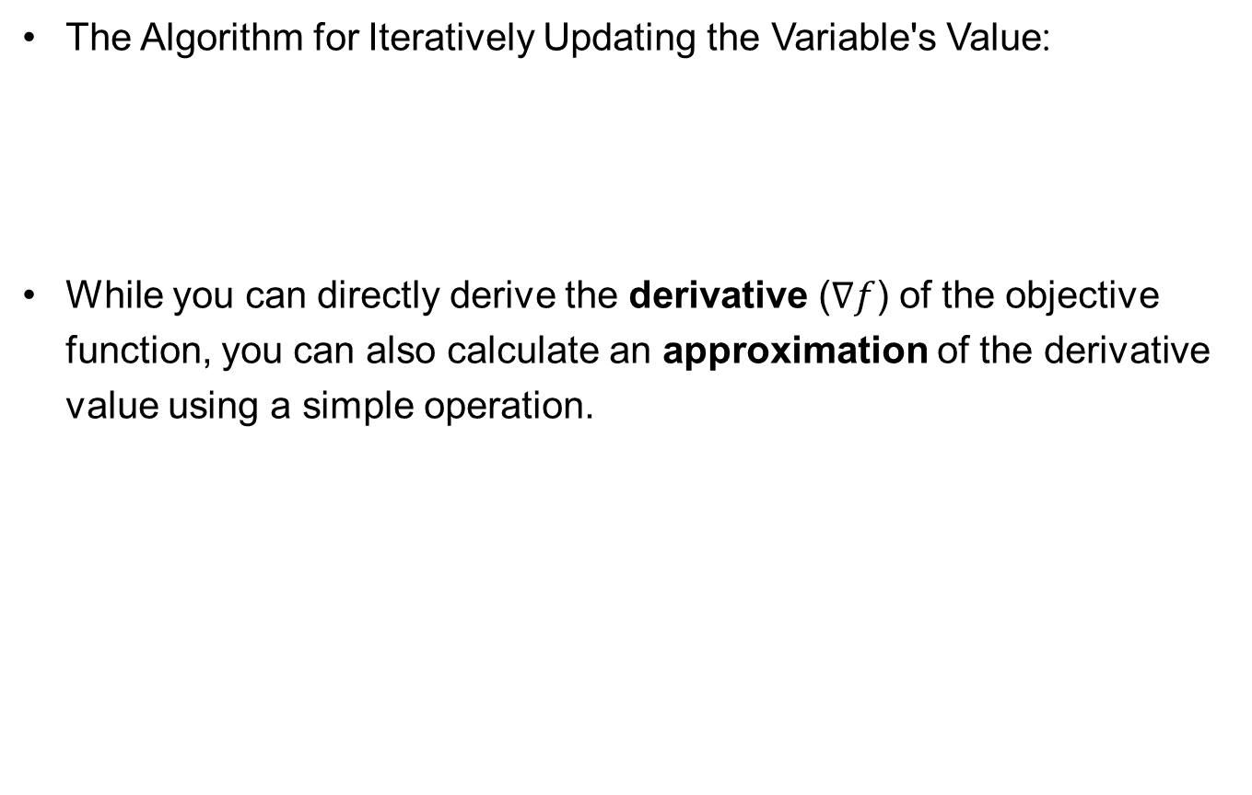
Gradient Descent Algorithm
The Algorithm for Iteratively Updating the Variable's Value:
While you can directly derive the derivative ($∇f$) of the objective function, you can also calculate an approximation of the derivative value using a simple operation.
x_{new} ← x_{current} – α∇f(x_{current})

Slide 16
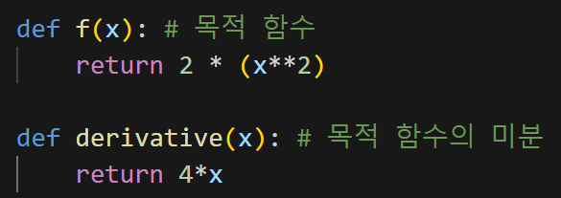
Gradient Descent Algorithm
Python practice 1
Using the GD algorithm to minimize f(x)=2x^2
Define the Objective Function and its Derivative Function

Slide 17
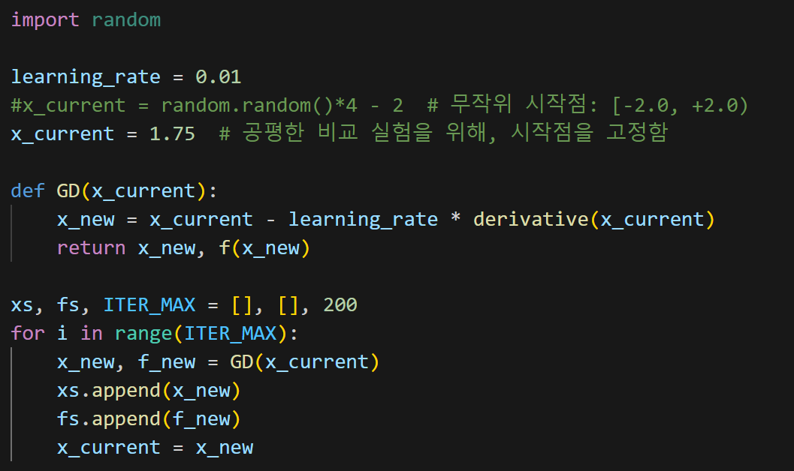
Gradient Descent Algorithm
Python practice 1
Using the GD algorithm to minimize f(x)=2x^2
Implementing GD algorithm

Slide 18
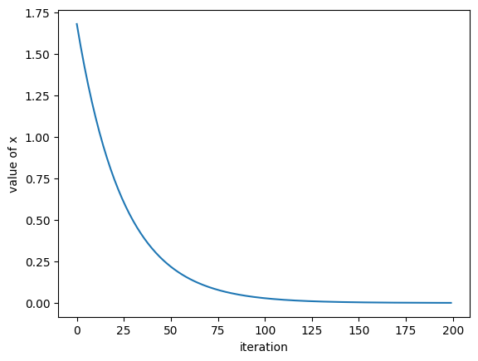
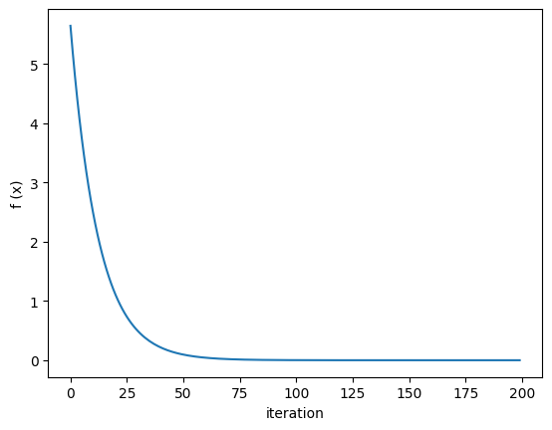
Gradient Descent Algorithm
Python practice 1
Using the GD algorithm to minimize f(x)=2x^2
Experiment result (learning_rate = 0.01)

Slide 19
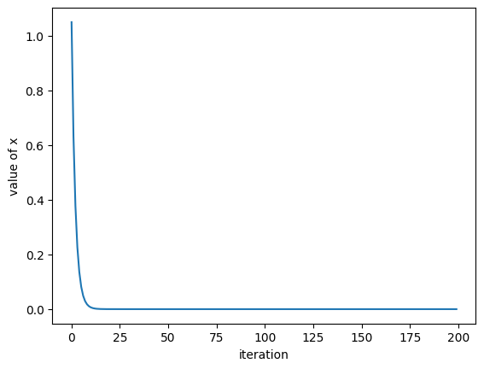
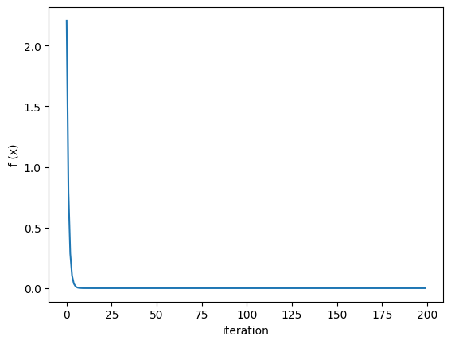
Gradient Descent Algorithm
Python practice 1
Using the GD algorithm to minimize f(x)=2x^2
Experiment result (learning_rate = 0.1)
Lr is increased, converging quicker

Slide 20
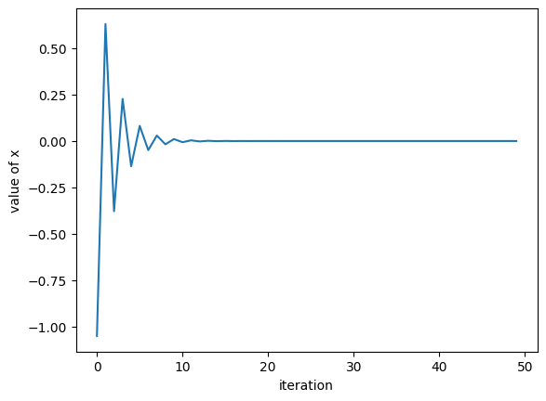
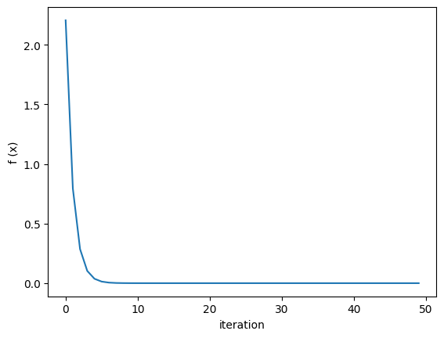
Gradient Descent Algorithm
Python practice 1
Using the GD algorithm to minimize f(x)=2x^2
Experiment result (learning_rate = 0.4, ITER_MAX=50)
Unstable convergence at the start

Slide 21
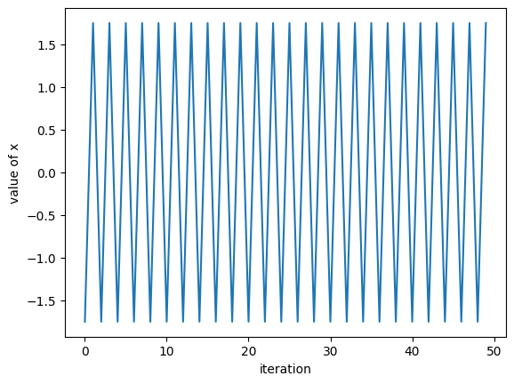
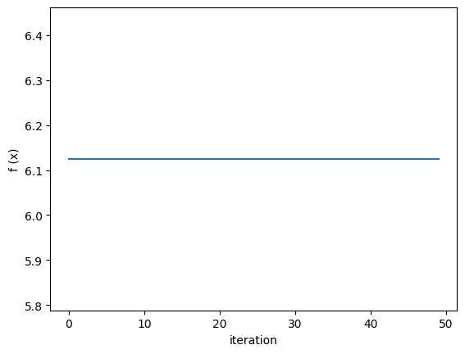
Gradient Descent Algorithm
Python practice 1
Using the GD algorithm to minimize f(x)=2x^2
Experiment result (learning_rate = 0.5, ITER_MAX=50)
Zig-zag over minimum value

Slide 22
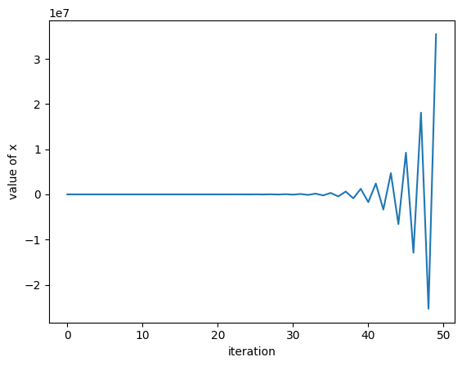
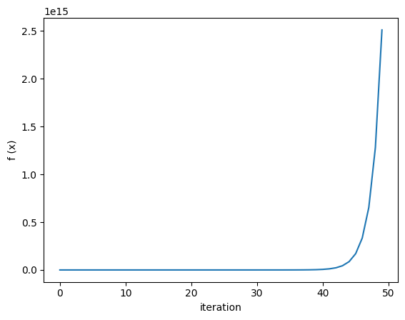
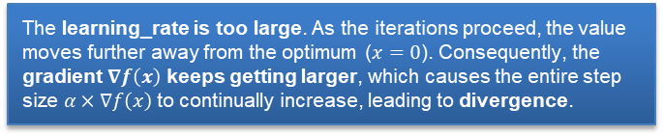
Gradient Descent Algorithm
Python practice 1
Using the GD algorithm to minimize f(x)=2x^2
Experiment result (learning_rate = 0.6, ITER_MAX=50)
Diverged, fails to converge
The learning_rate is too large. As the iterations proceed, the value moves further away from the optimum ($x=0$). Consequently, the gradient $∇f\left(x\right)$ keeps getting larger, which causes the entire step size $α×∇f\left(x\right)$ to continually increase, leading to divergence.

Slide 23
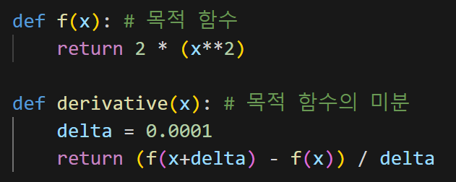
Gradient Descent Algorithm
Python practice 2
Using the GD algorithm to minimize f(x)=2x^2
Using the derivative value based on the limit definition instead of direct derivative

Slide 24

Gradient Descent Algorithm
Python practice 2
Using the GD algorithm to minimize f(x)=2x^2
Experiment result (learning_rate = 0.01, ITER_MAX=200)
The result is (almost) identical to the result obtained by calculating and using the analytical derivative.

Slide 25
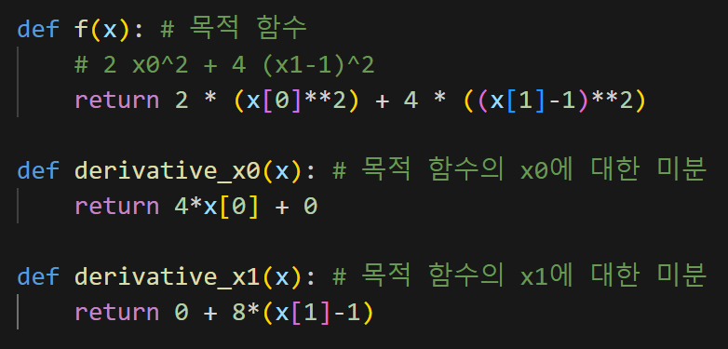
Gradient Descent Algorithm
Python practice 3
Using the GD algorithm to minimize f(x)=2x₀^2+4(x₁-1)^2
Vector variable x = [x₀, x₁]

Slide 26
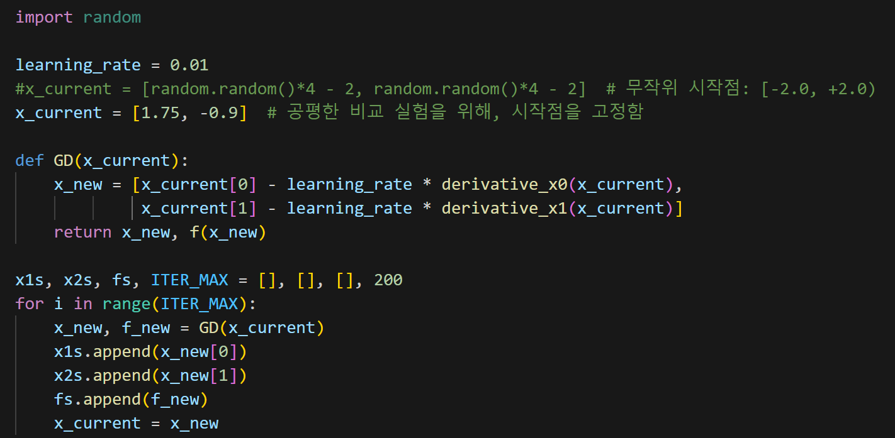
Gradient Descent Algorithm
Python practice 3
Using the GD algorithm to minimize f(x)=2x₀^2+4(x₁-1)^2
Implement GD to take account of the vector variable

Slide 27
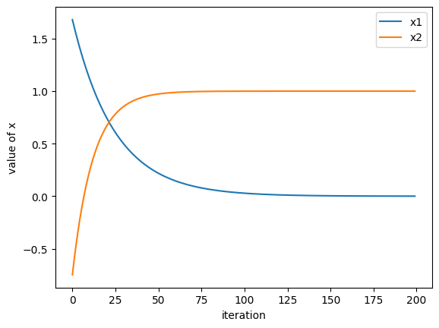
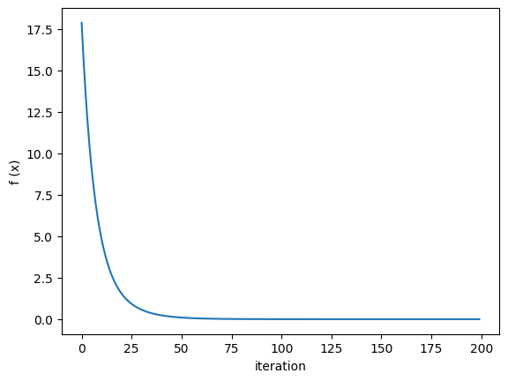
Gradient Descent Algorithm
Python practice 3
Using the GD algorithm to minimize f(x)=2x₀^2+4(x₁-1)^2
Experiment result (learning_rate = 0.01)

Slide 28
Adding Gradient Descent (for Numeric Optimization problems)
Based on the content covered so far, let's learn how to implement Gradient Descent for a given Numerical Optimization problem!

Slide 29
Adding Gradient Descent (for Numeric Optimization problems)
Gradient descent is the same as the steepest-ascent except the way a next point is created from the current point
Gradient descent generates only one neighbor
c.f.) Steepest ascent generates m neighbors from which to select a successor to move to (m evaluations are needed)
Gradient descent computes gradient at the current point and apply the gradient update rule to calculate the next point
n evaluations are needed to calculate partial derivatives in all the dimensions, where n is the dimension of the objective function (i.e., n = number of variables)
One more evaluation is needed to evaluate the next point obtained by applying the update rule using the gradient
Gradient descent is applicable only to numerical optimization

Slide 30
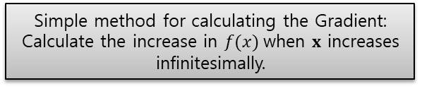
Adding Gradient Descent (for Numeric Optimization problems)
Two variables are newly added to the Numeric subclass:
alpha: update rate for gradient descent
Set to a default value of 0.01 for the time being
Referenced by the method takeStep
dx: size of the increment used when calculating derivative
Set to a default value of 10^{–4} for the time being
Referenced by the method gradient
x ← x – α ∇f(x)
Simple method for calculating the Gradient: Calculate the increase in $f(x)$when $x$ increases infinitesimally.

Slide 31
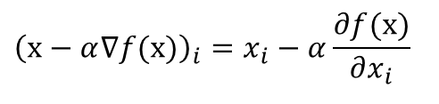
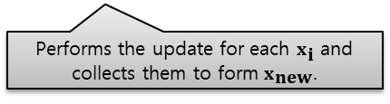
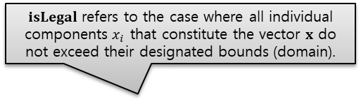
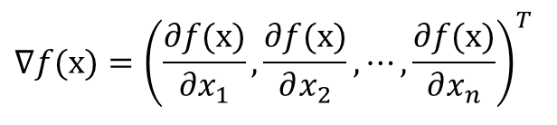
Adding Gradient Descent (for Numeric Optimization problems)
Also, following methods are newly added to the Numeric subclass:
takeStep(self, x, v):
Computes the gradient (gradient) of the current point x whose objective value is v
Makes a copy of x and changes it to a new one by applying the gradient update rule as long as the new one is within the domain (isLegal)
$$∇f(x)={\left(\frac{∂f(x)}{∂x_{1}},\frac{∂f(x)}{∂x_{2}},⋯,\frac{∂f(x)}{∂x_{n}}\right)}^{T}$$
$isLegal$ refers to the case where all individual components $x_{i}$ that constitute the vector $x$ do not exceed their designated bounds (domain).
x_{i} ←
$${\left(x−α∇f(x)\right)}_{i}=x_{i}−α\frac{∂f(x)}{∂x_{i}}$$
if x_new is legal, return x_new
else return x
Performs the update for each $x_{\text{i}}$ and collects them to form $x_{\text{new}}$.

Slide 32
Adding Gradient Descent (for Numeric Optimization problems)
gradient(self, x, v)
Calculates partial derivatives at x
x′ = (x₁, . . . , x_{i–1}, x_{i} + δ, x_{i+1}, . . . , x_{d})^{T}
Returns the gradient ∇f(x)
isLegal(self, x)
Checks if x is within the domain for each x_i in x
getAlpha(self)
getDx(self)
getAlpha and getDx are called from displaySetting of the main program when reporting the update rate and the increment size for calculating derivative

Slide 33
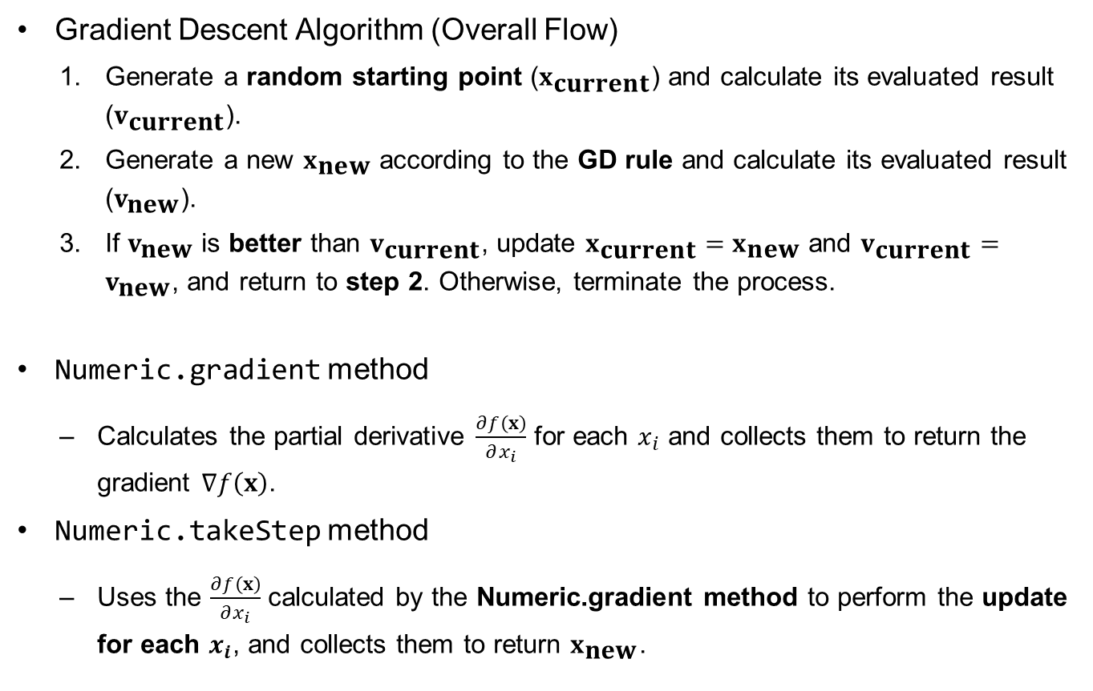
Adding Gradient Descent (for Numeric Optimization problems)
Gradient Descent Algorithm (Overall Flow)
Generate a random starting point ($x_{\text{current}}$) and calculate its evaluated result ($v_{\text{current}}$).
Generate a new $x_{\text{new}}$ according to the GD rule and calculate its evaluated result ($v_{\text{new}}$).
If $v_{\text{new}}$ is better than $v_{\text{current}}$, update $x_{\text{current}}=x_{\text{new}}$ and $v_{\text{current}}=v_{\text{new}}$, and return to step 2. Otherwise, terminate the process.
Numeric.gradient method
Calculates the partial derivative $\frac{∂f\left(x\right)}{∂x_{i}}$ for each $x_{i}$ and collects them to return the gradient $∇f\left(x\right)$.
Numeric.takeStep method
Uses the $\frac{∂f\left(x\right)}{∂x_{i}}$ calculated by the Numeric.gradient method to perform the update for each $x_{i}$, and collects them to return $x_{\text{new}}$.

Slide 34
Final Class Hierarchy
variables
functions
Numeric
expression
domain
delta = 0.01
alpha
dx = 10 ** (-4)
Gradient Descent implementation part
__init__
setVariables
getDelta (new)
randomInit
evaluate
mutants
mutate
randomMutant
describe
report
coordinate
getAlpha
getDx
takeStep
gradient
isLegal

Slide 35
GD Implementation Code File
gradient descent.py
def main():
p = Numeric()
...
def gradientDescent(p):
...
def displaySetting(p):
...
main()

